Slide 1
SEBA ( সেবা) A NGO MANAGEMENT SYSTEM Presented by: Quest
Ashfaq Ali Shafin ID: 14.01.04.111
Irtiza Abir ID: 14.01.04.122
Abid Hasan Prottoy ID: 14.01.04.125

Slide 2
Information Gathering & Interview
Objectives
Construct meaningful interview questions
Understanding the client & organization’s view
Understanding the current system
Identify preferred transaction method
Requirement & features Analysis
Creating Use case diagram
Creating data flow diagram

Slide 3
Questionnaires & Interview Pattern
For information gathering we have chosen three methods.
Interview
Questionnaires
Investigation

Slide 4
Interview Structure
Interview structure was Funnel type
9 open ended question in beginning.
4 close ended question after that.

Slide 5
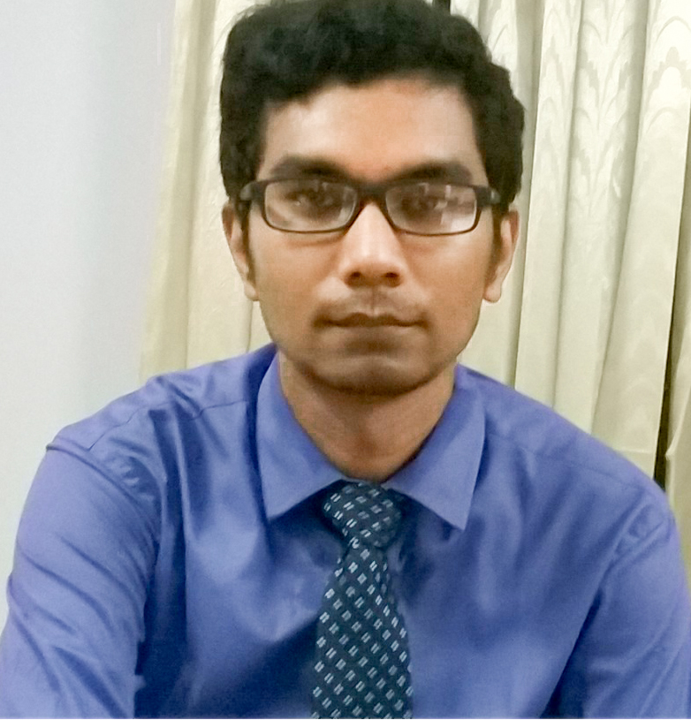
Selection Of Interviewe
Interviewee
Mr. Tanjeer Bin Hauque
Lead Engineer at ASA
ASA Tower, 23/3, Bir Uttam A.N.M. Nuruzzaman Sharak, Shyamoli, Mohammadpur, Dhaka-1207, Bangladesh
Mobile:+8801708516936

Slide 6
Interview Question
Question 01: How ASA operates their program?
Answer: ASA is not a donor based NGO. We are self-financed in most of the projects now. But in the past like in 1970-1980 donation system was available for the organization.
Question 02: In which projects you grant a donor?
Answer: Some projects like sanitization, agricultural development, we accept donation from different organizations like World Bank, Save the Children.
Question 03: Why does World Bank/Save the Children collaborate with NGO?
Answer: The clients of NGO are mostly under developed and live in rural areas. Sometimes it is a difficult task for the donors to reach their desired clients. So we merge together for some particular projects like Sanitization, Agricultural development etc.

Slide 7
Interview Question
Question o4: What is the process behind selecting the clients?
Answer: We have distributed branches all over Bangladesh. So, in a particular area there are Branch Managers and Area Managers who select the clients. Most of the times these managers are local. So they analyze the whole process to find out the eligible candidates for the loan program. Sometimes it is preferable to select a client with a reference from other trusted clients.
Question 05: Is there any other criteria, that is followed to select a client for the micro-finance activity like their potential level, poverty level etc?
Answer: Yes, we select those candidates who are willing to change their current poverty level and utilize resources potentially.
Question 06: How does branch manager communicate with main branch? Is there a web based system for that?
Answer: No, we don’t have any direct web based system for that. Desktop based system is used for branches. Branch managers collect information and store them at the desktop system.

Slide 8
Interview Question
Question 07: How does a member communicate with the system?
Answer: For getting the loan the member must come to the area branch to collect the loan. After that they communicate through the area operator. An area operator is assigned for a group of 30-35 people. They meet in a common place weekly to be updated. Then the area operator takes the updated information in a register notebook. This information then stored in the system from the register book.
Question 08: Isn’t it an old manual process?
Answer. Yes, it is. But recently we have taken some initiative to the automation process. Currently in Dhaka, we have distributed Android Tablets to the Area Operators which is used for collecting data and information. This is not fully functional to the whole country. By the time of 2018, the full process will be automated. But it has some obstacles.
Question 09: What are the obstacles we are talking about?
Answer: It is difficult to have an internet connection in the rural areas where not even electricity is provided.

Slide 9
Interview Question
Question 10: Can the clients get the current information of the activity through the web?
Answer: No, currently we do not have that.
Question 11: So how can the clients get the current information of the activity?
Answer: By the area manager and area operator.
Question 12: What method is used by the main branch to collect the information from the local branches?
Answer: It is an automated process. We collect the information on a monthly basis.
Question 13: Which program of ASA has the most members?
Answer: Micro-finance.

Slide 10
Questionnaires
Question No: 09
Question Type: Specific

Slide 11
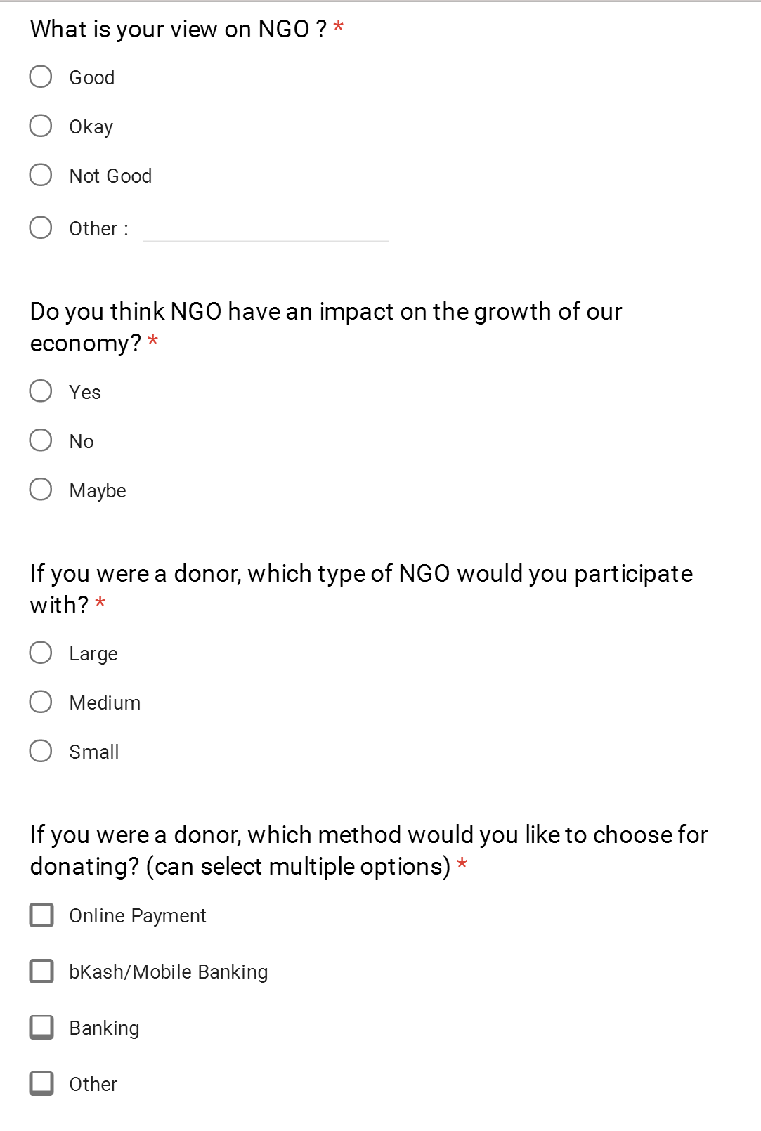
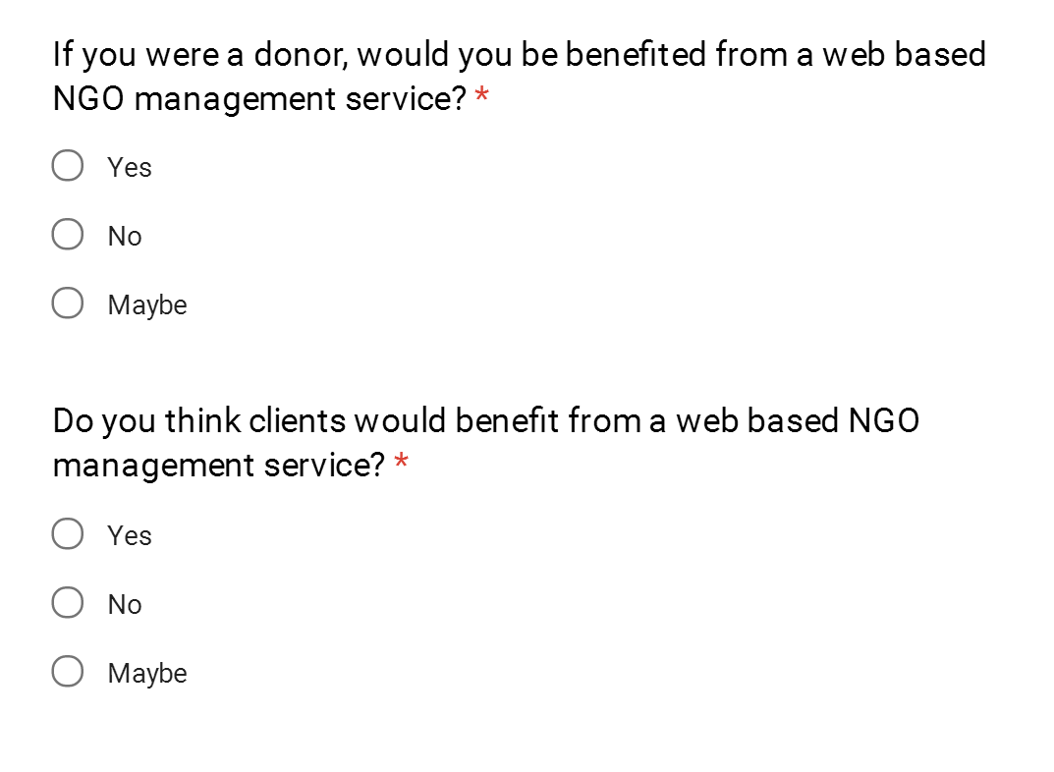
Questionnaires

Slide 12
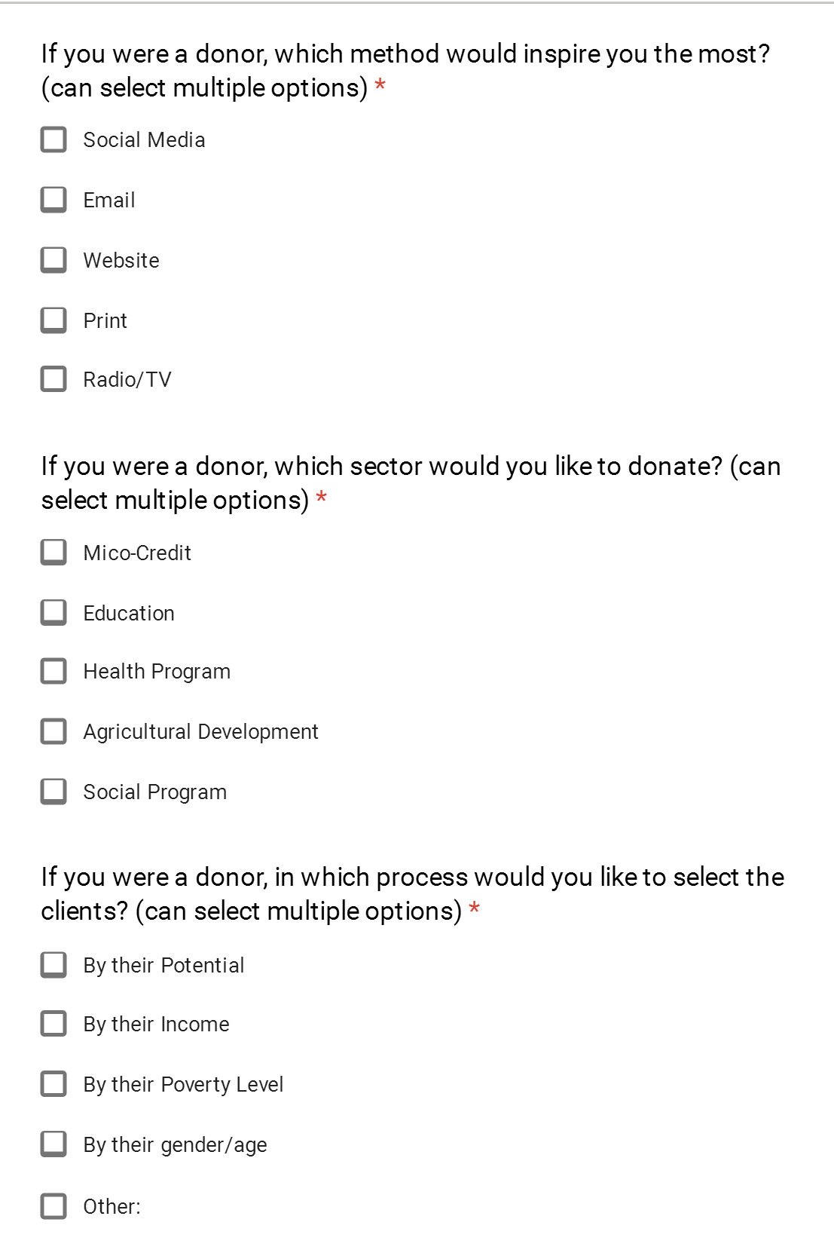
Questionnaires

Slide 13
Survey Results (Continued)

Slide 14
Survey Results (Continued)
Count of View on NGO

Slide 15
Survey Results (Continued)

Slide 16
Survey Results (Continued)

Slide 17
Survey Results (Continued)

Slide 18
Survey Results (Continued)

Slide 19
Survey Results (Continued)

Slide 20
Survey Results (Continued)

Slide 21
Survey Results (Continued)

Slide 22
Survey Results (Continued)

Slide 23
Investigation
Bangladesh is the 3rd country in Asia having most NGOs
Top 5 causes are
Education
Children & Youth
Women & Girls
Health & Safety
Civil Rights
86% agree that social media is effective for online fund raising.

Slide 24
Investigation

Slide 25
Revised Requirement Analysis
Impact on Economy: High
Donation Selection: Medium type of NGO
Donation Method: Banking system
Donation Criteria: Education system
Importance of Web Based System: High

Slide 26
Summary
Minor changes for donor
Advertisement feature

Slide 27


